Slide 1


CNN Integrated With XGBoost For Congenital Heart
Disease Detection In Patients Based On
Machine Learning
Jerin Thomas
Department of Computer Science and Engineering,
Medi-Caps University,
A.B. Road, Rau, Indore – 453331, India
ARET - 2025

Slide 2

Introduction
Congenital Heart Disease (CHD) is one of the leading causes of infant mortality worldwide.
Early detection of CHD is critical for timely intervention and improved patient outcomes.
Traditional diagnostic methods using manual interpretation of medical imaging are time-consuming and prone to errors.
Recent advancements in Artificial Intelligence (AI) have enabled automated disease detection with improved accuracy and reliability.
This research proposes a hybrid deep learning model combining CNN and XGBoost for the automated detection of CHD from chest X-ray images.
ARET - 2025

Slide 3
Background of the Paper
Congenital Heart Disease (CHD) primarily involves structural abnormalities of the heart present at birth.
Early symptoms can be subtle and often require imaging techniques like X-rays for detection.
Deep learning models like CNNs can automatically learn spatial patterns from medical images, reducing reliance on manual feature engineering.
Gradient boosting algorithms, such as XGBoost, enhance classification performance on structured and high-dimensional data.
Combining deep feature extraction (CNN) with ensemble learning (XGBoost) has proven effective in improving detection outcomes in medical diagnosis tasks.
ARET - 2025

Slide 4
Related works
Zhixin et al. (2024): Released CHD-CXR dataset comprising pediatric chest X-rays for deep learning-based CHD classification.
Sharifi & Donyadadi (2024): Applied EfficientNetV2 and ResNeSt models for CHD detection from chest X-rays, achieving 92.5% accuracy.
Hou et al. (2024): Integrated explainable AI techniques (Grad-CAM, LIME) with deep learning models for interpretable cardiac disease detection using X-rays.
Jiang et al. (2023): Developed a deep learning model utilizing multi-view echocardiograms for pediatric CHD detection.
Li et al. (2023): Proposed explainable AI frameworks for improving cardiac disease classification from chest radiographs.
ARET - 2025

Slide 5
Problem Formulation
Manual diagnosis of Congenital Heart Disease (CHD) from X-ray images is time-intensive and prone to human error.
Traditional machine learning methods struggle to extract complex spatial features from chest radiographs.
There is a need for an automated, accurate, and clinically interpretable system for CHD detection.
Combining deep feature extraction (CNN) with structured data classification (XGBoost) can enhance detection performance.
Explainable AI (XAI) is essential to ensure transparency and clinical trust in model detections.
ARET - 2025

Slide 6
Proposed System
CNN extracts deep spatial features from chest X-ray images.
XGBoost classifier predicts CHD or No-CHD from extracted features.
The hybrid CNN + XGBoost architecture improves detection accuracy and robustness.
SHAP explainability ensures model transparency in clinical settings.
ARET - 2025

Slide 7
Proposed System – Model Pipeline
Input: Chest X-ray image.
Preprocessing: Resizing and normalization.
Feature Extraction: Deep features generated using CNN (ResNet50).
Classification: Features passed to XGBoost for binary classification.
Interpretation: SHAP applied to explain feature impact on detections.
ARET - 2025

Slide 8
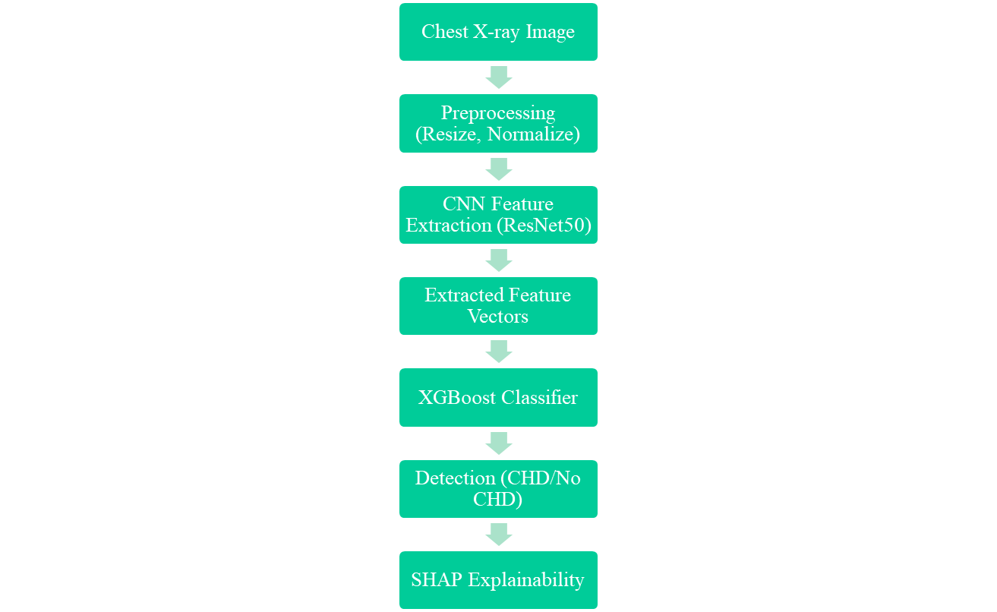
Proposed System – System Pipeline Diagram
ARET - 2025

Slide 9
Proposed System – CNN Feature Extraction
Used a pretrained CNN architecture (ResNet50).
Extracted deep hierarchical features from chest X-ray images.
The CNN backbone captures spatial patterns like texture, intensity variation, and structural abnormalities.
Output: Feature vector passed to the classifier.
ARET - 2025

Slide 10
Proposed System – XGBoost Classifier
XGBoost: eXtreme Gradient Boosting decision-tree algorithm.
Parameters used:
  n_estimators = 100
  learning_rate = 0.05
  max_depth = 4
Optimizes binary log-loss to enhance classification.
Provides feature importance rankings based on gain and coverage.
ARET - 2025

Slide 11
Proposed System – SHAP Explainability
SHAP (SHapley Additive exPlanations) used to interpret model output [1].
Identifies which features most strongly influence model detections.
Provides both global (overall feature importance) and local (individual detection) explanations.
Enhances model trustworthiness for clinical applications.
ARET - 2025

Slide 12
Model Results
Table 1.1 Model Performance Metrics
Metric | Value
Accuracy | 89.11%
Precision | 90% (macro avg)
Recall | 89% (macro avg)
F1-score | 89% (macro avg)
ARET - 2025

Slide 13
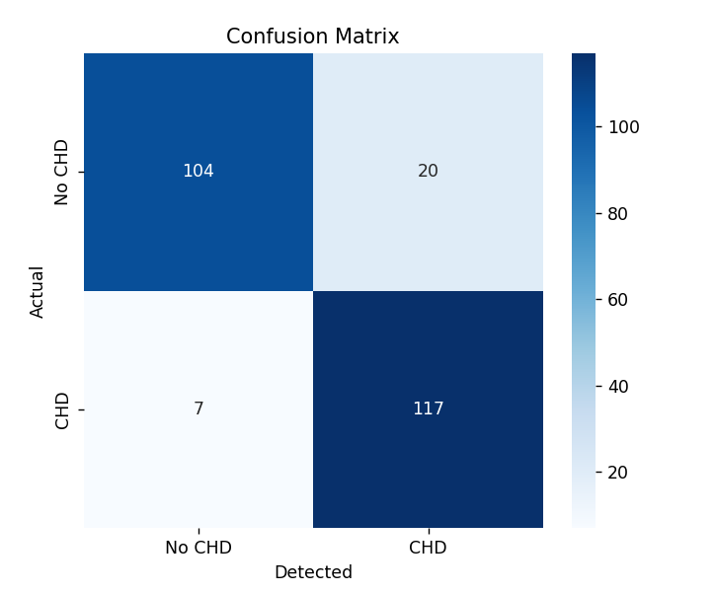
Confusion Matrix Analysis
117 patients correctly identified as CHD (True Positives).
104 patients correctly identified as No CHD (True Negatives).
20 patients falsely identified as CHD (False Positives).
7 patients falsely identified as No CHD (False Negatives).
ARET - 2025

Slide 14
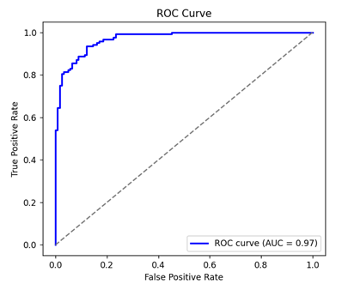
ROC Curve and AUC Score
The True Positive Rate or Sensitivity, is charted and compared against the False Positive Rate.
AUC = 0.97 shows that the model identifies CHD and No CHD cases correctly 97% of the time.
The nearer the AUC is to 1, the higher the performance of the model. As 0.97 is quite near 1, the model performs extremely well in separating positive and negative cases.
ARET - 2025

Slide 15
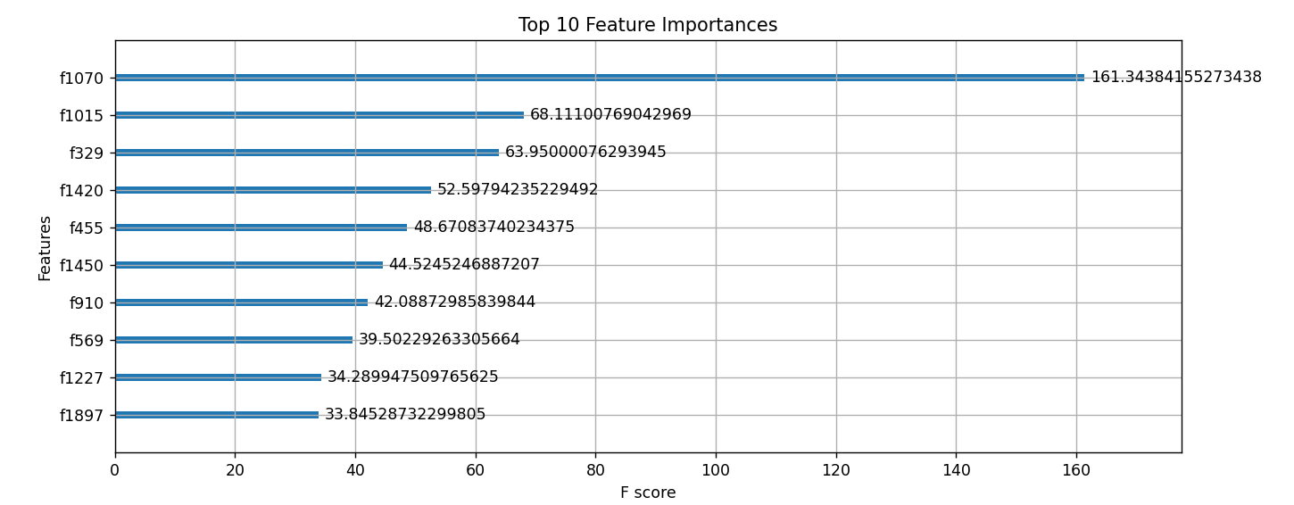
Feature Importance
Feature f1070 is most critical, with an F-score of 161.34, indicating that it contributes the greatest to CHD classification.
The other most significant features such as f1015 (68.11), f329 (63.95), and f1420 (52.59) also contribute heavily.
The F-score is how often a feature becomes significant in the model's decision trees. The higher the score, the more important in classification decisions.
ARET - 2025

Slide 16
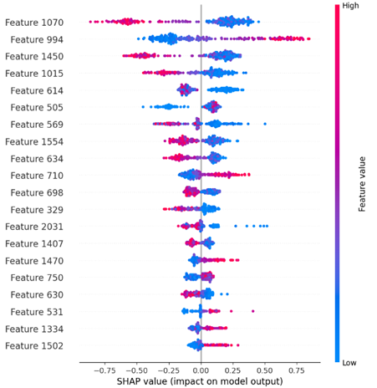
SHAP Summary Plot
ARET - 2025

Slide 17
Comparison
Table 1.2 Comparison with previous models
Model | Year | Accuracy (%)
Zhang et al. (CHD-CXR, Basic CNN) | 2024 | ~85%
Sharifi & Donyadadi (EfficientNetV2) | 2024 | 92.5%
Proposed CNN + XGBoost (Ours) | 2025 | 89.11%
ARET - 2025

Slide 18
Comparison
Zhang et al. (2024) achieved ~85% accuracy using basic CNN models on the CHD-CXR dataset [2].
Sharifi & Donyadadi (2024) reported 92.5% accuracy using EfficientNetV2 architecture for CHD classification [3].
The proposed CNN integrated with XGBoost model achieved 89.11% accuracy, demonstrating competitive performance with simpler architecture and improved explainability via SHAP.
The proposed system provides a practical balance between performance, computational efficiency, and clinical interpretability.
ARET - 2025

Slide 19
Advantages & Limitations
Advantages:
Combines deep feature extraction (CNN) with powerful classification (XGBoost) for improved CHD detection.
Achieves a high accuracy of 89.11% with a strong AUC of 0.97.
SHAP explainability adds transparency and clinical trust to model detections.
Computationally more efficient than very deep architectures like EfficientNetV2.
Limitations:
Slightly lower accuracy compared to specialized large-scale deep models (e.g., EfficientNetV2).
Performance can be affected by dataset quality and imbalance (small sample size).
Model explainability is currently limited to feature-level interpretation, not full image-level diagnosis.
Further validation needed across multi-center and larger diverse datasets.
ARET - 2025

Slide 20
Conclusions
A hybrid deep learning model integrating CNN feature extraction with XGBoost classification was developed for CHD detection from chest X-ray images.
The proposed model achieved a high accuracy of 89.11% and an AUC of 0.97.
SHAP-based explainability enhances clinical trust by highlighting key features influencing model detections [4].
The proposed system demonstrates the potential for assisting radiologists in early and accurate CHD diagnosis.
ARET - 2025

Slide 21
Future work
Expand dataset size with multi-center, real-world clinical data to improve model generalization.
Incorporate multi-modal data inputs, including ECG and MRI imaging, alongside X-rays.
Explore advanced deep learning architectures like Transformer-based models for feature extraction.
Develop a lightweight mobile application for real-time CHD screening support in clinical settings.
ARET - 2025

Slide 22
References
[1] S. Hou et al., “Explainable Deep Learning for Aortic Elongation Detection from Chest X-rays,” European Heart Journal - Digital Health, UK, Vol. 5, Issue 5, pp. 524–534, 2024.
[2] Zhixin et al., “A Publicly Available CHD-CXR Dataset for Congenital Heart Disease Detection,” Frontiers in Cardiovascular Medicine, China, Vol. 11, Article 1351965, 2024.
[3] A. Sharifi, R. Donyadadi, “EfficientNetV2-Based Deep Learning for Congenital Heart Disease Classification,” International Journal of Advanced Data Science and Engineering, Iran, Vol. 3, Issue 2, pp. 45–52, 2024.
[4] H. Li, Y. Chen, “Explainable AI in Cardiac Disease Detection from Radiographs,” Computers in Biology and Medicine, USA, Vol. 162, Article 107233, 2023.
ARET - 2025

